Slide 1

Assignment 5 Report

Slide 2
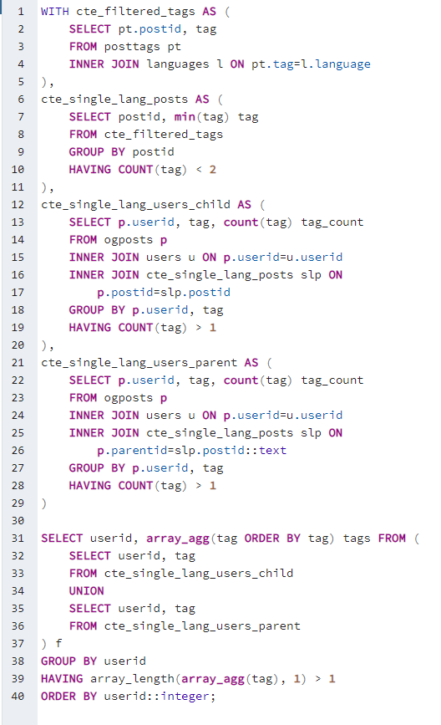
Data Cleaning
Postgres sql

Slide 3
Basket Analysis
82015,javascript,php 54978,java,javascript 50045,c#,javascript 32232,javascript,sql 31737,java,php 30760,javascript,python 29616,c#,java 28389,c#,sql 26531,java,python 23424,c++,java 23180,php,sql 22531,c#,php 21958,java,sql 20274,c,c++ 19921,java,javascript,php 18204,c++,python 18037,c#,c++ 17954,php,python 17685,c++,javascript 17171,c,java 16603,javascript,php,sql 16016,c#,javascript,sql 15367,javascript,ruby
15272,c#,javascript,php 15147,c#,java,javascript 13697,c#,python 13287,c,python 12958,java,javascript,sql 12472,java,javascript,python 12366,c,javascript 12216,c++,php 11900,javascript,php,python 10816,python,sql 10387,objective-c,swift 10301,c,c# 10248,c#,java,php 9797,c,c++,java 9747,c++,java,javascript 9589,java,php,sql 9529,javascript,objective-c 9230,c,php 9209,c#,java,sql 8909,c#,php,sql 8875,c#,c++,java 8503,c++,java,python 8479,java,php,python
8314,java,objective-c 8010,c++,sql 8008,c++,javascript,php 7973,c#,java,javascript,php 7965,c,c++,python 7826,c#,c++,javascript 7778,java,ruby 7702,c,java,javascript 7668,c#,javascript,python 7588,c#,java,python 7538,java,javascript,php,sql 7412,php,ruby 7155,c,c#,c++ 7135,c++,java,php 7077,c#,javascript,php,sql 7053,c,java,python 6999,c++,javascript,python 6997,c,c++,javascript 6887,objective-c,php 6711,javascript,python,sql 6654,c#,java,javascript,sql 6444,java,javascript,php,python 6374,c,c#,java

Slide 4
Clustering Analysis (0.05)
Cluster 0 Cluster 1 Cluster 2 sather, 0.318345040845947 jscript, 0.22824007265514878 javafx, 0.11685043826576981 genie, 0.1078507311606257 Cluster 3 powerscript, 0.5877579660218822 uniface, 0.282398553370716 Cluster 4 Cluster 5 Cluster 6 javafx, 0.32457572059016726 oz, 0.22629775940247637 c, 0.17967791765953642 jscript, 0.1288232545615081 spss, 0.09247158148342843 Cluster 7 atlas, 0.5295380985223047 haskell, 0.09243697184829205
Cluster 8 apex, 0.39490291828200874 vhdl, 0.06792667678204832
Cluster 9 pascal, 0.34577578796964725 sed, 0.24054380840080708 ballerina, 0.14964397771800994 avenue, 0.055842703599660794 ksh, 0.05547963381305941 Cluster 10 autohotke, 0.22529365050807615 spark, 0.10274112474033105 jade, 0.06613606611997087 Cluster 11 curl, 0.24133998961973674 clu, 0.1253624809140613 xbase, 0.0563155412558777 Cluster 12 Cluster 13 puredata, 0.29158328671166533 brainfuck, 0.17714863781290685 c#, 0.13804160539237925 jscript, 0.12765617338528035 javafx, 0.12403512508627232 oz, 0.07243484397806156 Cluster 14 q, 0.25891869282814695 puredata, 0.2485048939943546 ballerina, 0.19443454005722163 xquery, 0.10951669917006471 mantis, 0.08385775723431092
Cluster 15 vala, 0.21082005592172445 vbscript, 0.15992795075768565 paradox, 0.07619161322654744 python, 0.06586861540215938 Cluster 16 c-omega, 0.15434463665704828 cg, 0.10732048054006489 angelscript, 0.10315419506112718 slate, 0.10123512891178589 Cluster 17 Cluster 18 Cluster 19 gosu, 0.8137234516423849 Cluster 20 spss, 0.45583735237032946 jscript, 0.4235200138526357 Cluster 21 c#, 0.22092194493250117 object pascal, 0.20364561571231693 c, 0.12832795412306217 supercollider, 0.1282676355246101 jscript, 0.12717300981192256 javafx, 0.09185489165043127
Cluster 22 nemerle, 0.14207316910072304 mdx, 0.06967502088295183 bash, 0.06639427208413688 Cluster 23 ring, 0.730487354033046 puredata, 0.07113421047958207 oz, 0.06470204202502274 Cluster 24 harbour, 0.3136021623032797 euphoria, 0.12038898088543332 powershell, 0.08733371419257145 clipper, 0.08132373829056702 c, 0.06564426414433464 ruby, 0.06445802536256837 lingo, 0.05834310824121134

Slide 5
Clustering Analysis (0.01)
Cluster 0 ioke, 0.02018969747140041 simula, 0.01660323184337487 dylan, 0.013963975030291599 zzz, 0.013578206678389684 openedge, 0.010193061111486757 Cluster 1 egl, 0.011908196864487705 Cluster 2 sather, 0.318345040845947 jscript, 0.22824007265514878 javafx, 0.11685043826576981 genie, 0.1078507311606257 emerald, 0.045315726145135335 oz, 0.04474769120357829 xpl, 0.01408819586729287 supercollider, 0.013600988224044533 scala, 0.013452686473885842 dcl, 0.011867764658973868 Cluster 3 powerscript, 0.5877579660218822 uniface, 0.282398553370716 4th-dimension, 0.032121011997093184
Cluster 4 mql4, 0.01975193713561728
Cluster 5 cl, 0.03730864291262698 Cluster 6 javafx, 0.32457572059016726 oz, 0.22629775940247637 c, 0.17967791765953642 jscript, 0.1288232545615081 spss, 0.09247158148342843 Cluster 7 atlas, 0.5295380985223047 haskell, 0.09243697184829205 xojo, 0.022834951657039883 xen, 0.012204346953107851 purebasic, 0.010102226327813001 Cluster 8 apex, 0.39490291828200874 vhdl, 0.06792667678204832 autolisp, 0.02780944705850329 xslt, 0.02591038326510764 Cluster 9 pascal, 0.34577578796964725 sed, 0.24054380840080708 ballerina, 0.14964397771800994 avenue, 0.055842703599660794 ksh, 0.05547963381305941 aspectj, 0.02654441148685126 tom, 0.02069070388216022
Cluster 10 autohotke, 0.22529365050807615 spark, 0.10274112474033105 jade, 0.06613606611997087 r, 0.037301866501128975 squirrel, 0.032079564328747465 bcpl, 0.022825755529932372 matlab, 0.019482468060823193 inform, 0.010480590696486124 Cluster 11 curl, 0.24133998961973674 clu, 0.1253624809140613 xbase, 0.0563155412558777 felix, 0.033493737382848776 hypertalk, 0.03241698215518616 rebol, 0.013463267376585592 d, 0.012436688588033887 aspectj, 0.011380559648680018 ch, 0.01127744059385275 Cluster 12 chapel, 0.011604584585860502 Cluster 13 puredata, 0.29158328671166533 brainfuck, 0.17714863781290685 c#, 0.13804160539237925 jscript, 0.12765617338528035 javafx, 0.12403512508627232 oz, 0.07243484397806156 spss, 0.01778854451202773
Cluster 14 q, 0.25891869282814695 puredata, 0.2485048939943546 ballerina, 0.19443454005722163 xquery, 0.10951669917006471 mantis, 0.08385775723431092 s-plus, 0.020019752832035935 jscript, 0.017528968140233043 forth, 0.0145321314062416 Cluster 15 vala, 0.21082005592172445 vbscript, 0.15992795075768565 paradox, 0.07619161322654744 python, 0.06586861540215938 glsl, 0.01960219223562609 lisp, 0.018546242670411023 exec, 0.011997734858180974 Cluster 16 c-omega, 0.15434463665704828 cg, 0.10732048054006489 angelscript, 0.10315419506112718 slate, 0.10123512891178589 solidity, 0.012423396765988722 spss, 0.010683710348345749 Cluster 17 netlogo, 0.03378134741192485 visual-basic, 0.013971772223186128

Slide 6
Scala
Frequent Item Lists | 5224, (java, scala)
Clustering | harbour, 0.3136021623032797 euphoria, 0.12038898088543332 powershell, 0.08733371419257145 clipper, 0.08132373829056702 c, 0.06564426414433464 ruby, 0.06445802536256837 lingo, 0.05834310824121134 nim, 0.03871694978655534 occam, 0.029958553835086305 scala, 0.01499392591198261
Clustering | sather, 0.318345040845947 jscript, 0.22824007265514878 javafx, 0.11685043826576981 genie, 0.1078507311606257 emerald, 0.045315726145135335 oz, 0.04474769120357829 xpl, 0.01408819586729287 supercollider, 0.013600988224044533 scala, 0.013452686473885842 dcl, 0.011867764658973868

